Slide 1
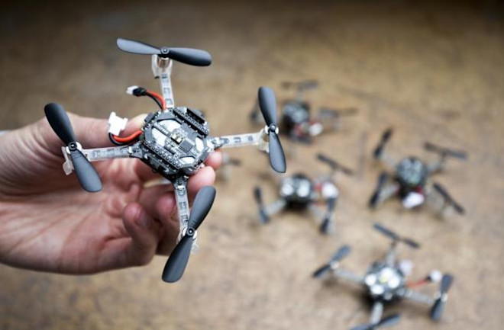
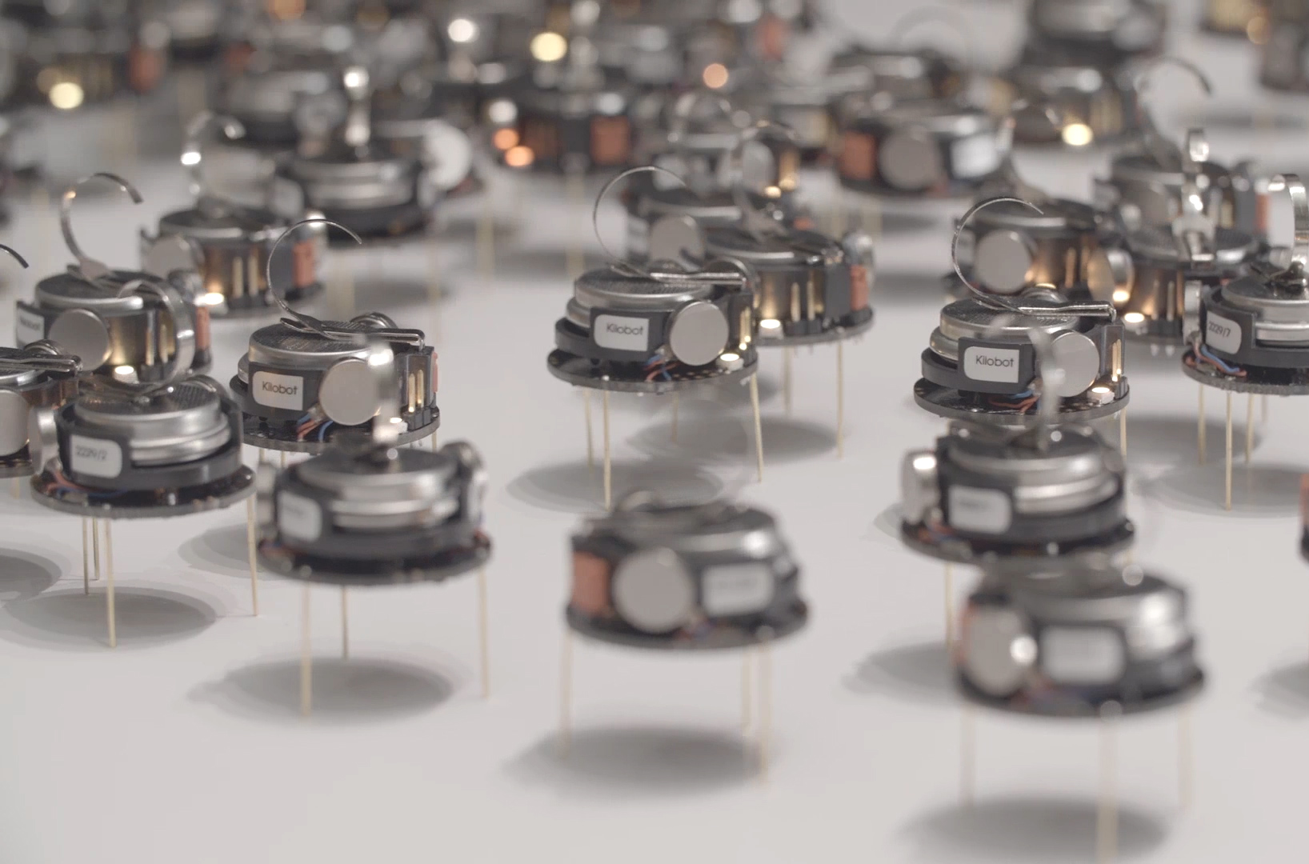
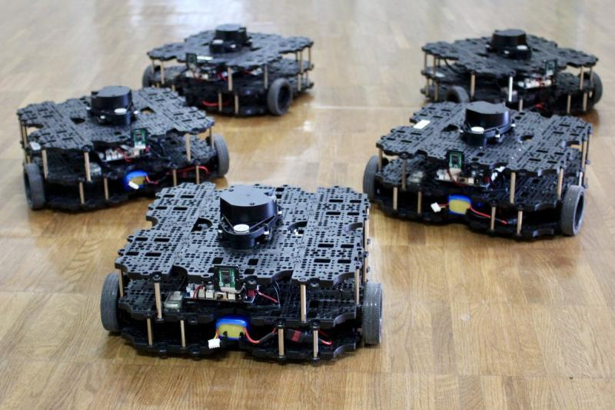

ECE693H, Spring 2025: Multi-robot System Design
“Action 2”
Dr. Daniel Drew

Slide 2
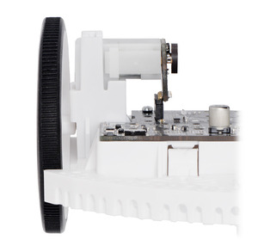
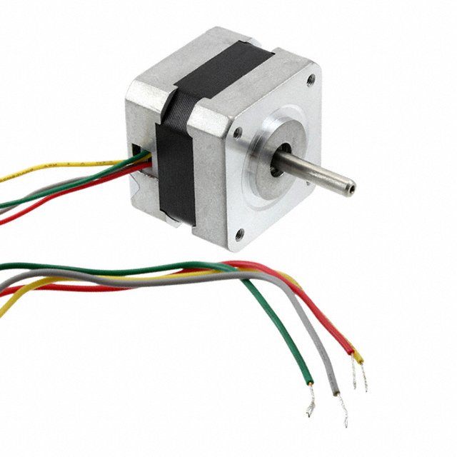
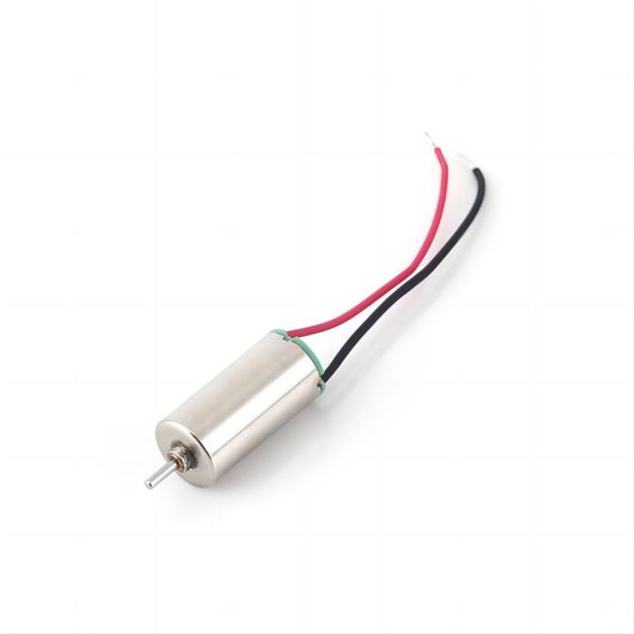
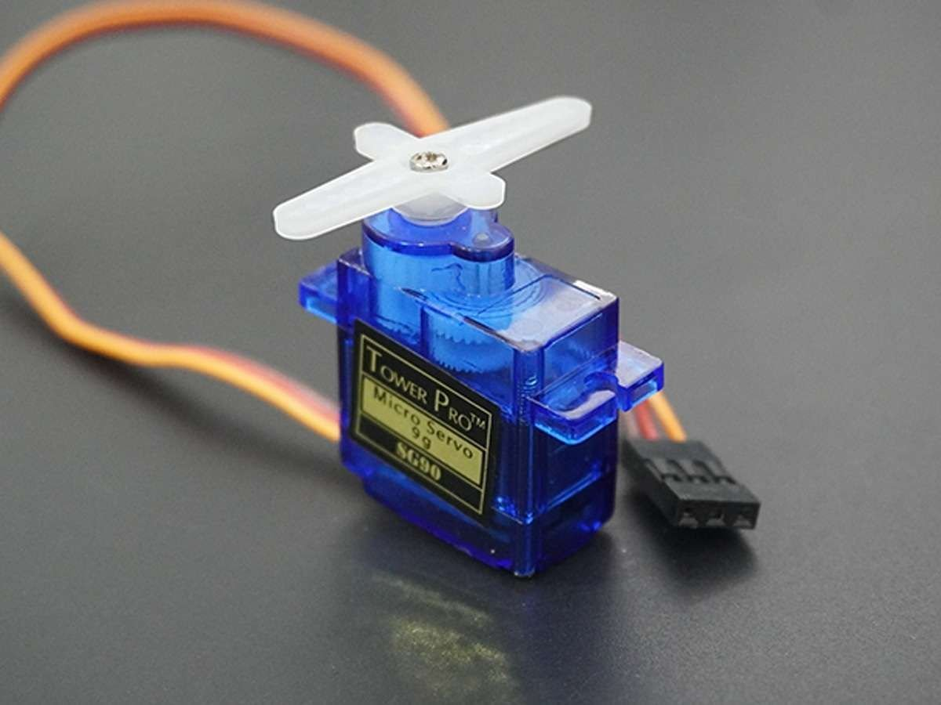
Action 1 Recap
Electromagnetic motors
Motor gearing and mechanics
Motor driver electronics
Encoders

Slide 3
Questions?

Slide 4
Class Overview
Lecture (~30 minutes)
Astound the Class! (~40 minutes)
Subsystem check-in (~5 minutes)

Slide 5
Action: Lecture 2 of 2
Lecture 1: motors → encoders
Lecture 2: motor control → motion planning

Slide 6
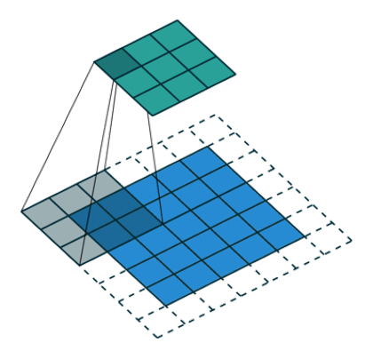
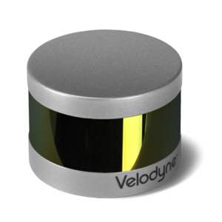
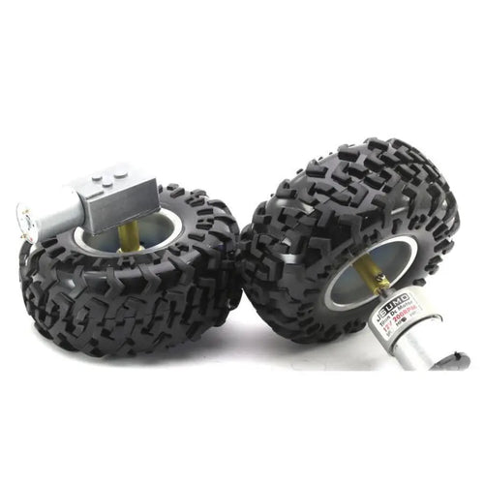
Lecture Overview: Intersection with Intelligence
Motor control
Odometry
Motion planning
Closing sensorimotor loops;
Algorithmic decision making
Action
Perception
Intelligence

Slide 7
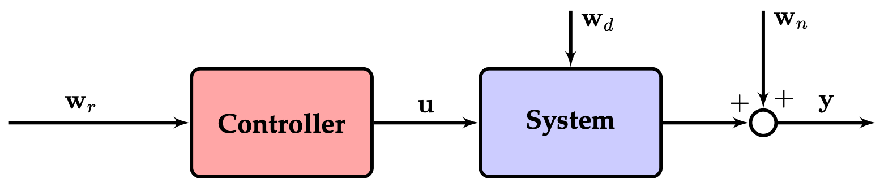
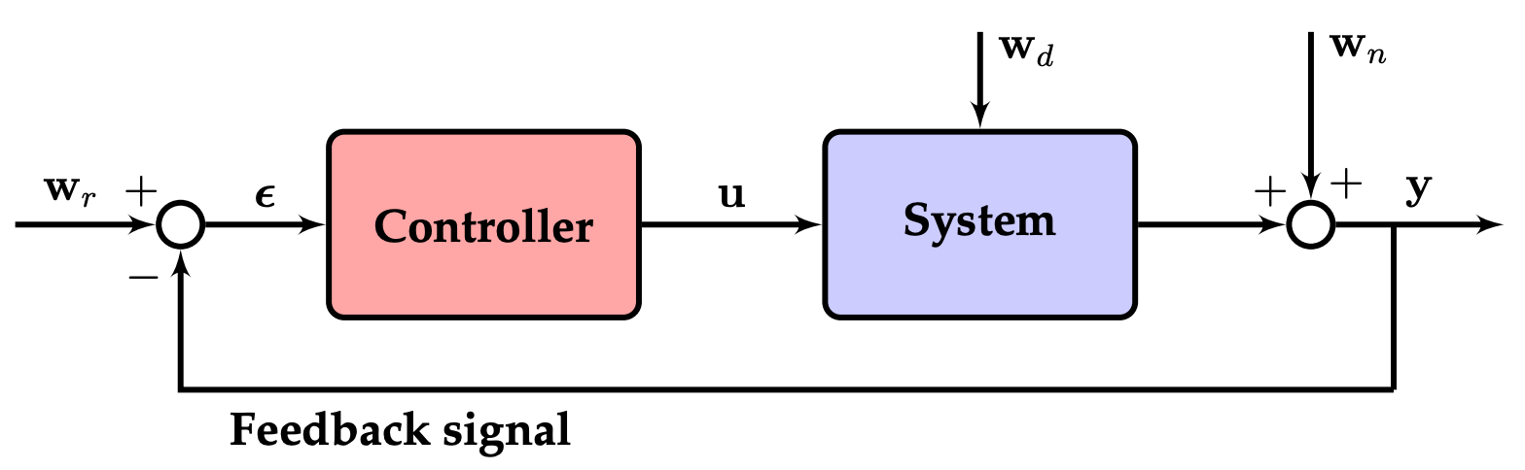
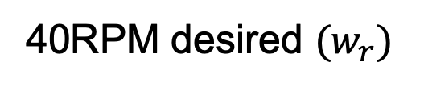
Motor Control: Feedback Principles
e.g.,
40RPM desired $(w_{r})$
40 * 0.8 = PWM%
“controller"
Open-loop control diagram
Might only work on flat ground, with full battery, for a perfectly assembled robot, with no payload, etc.
Feeds measurements of the ACTUAL RPM back to the controller
Closed-loop control diagram

Slide 8
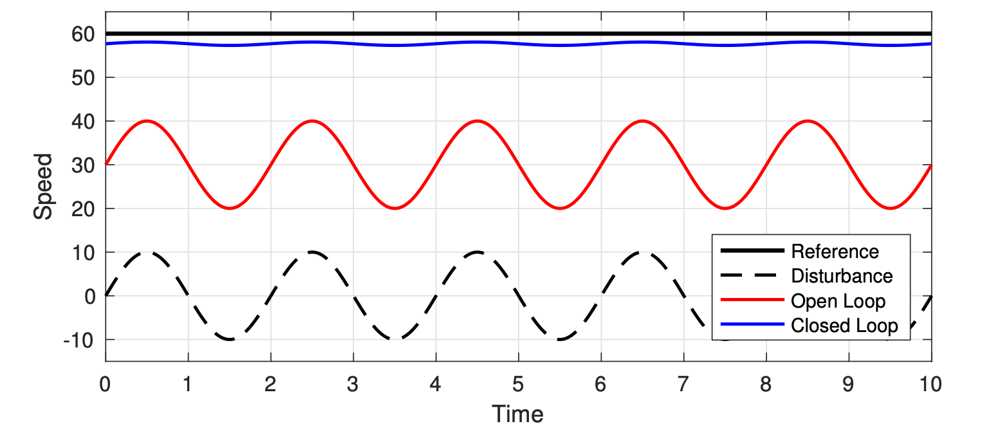
Motor Control: Feedback Principles

Slide 9
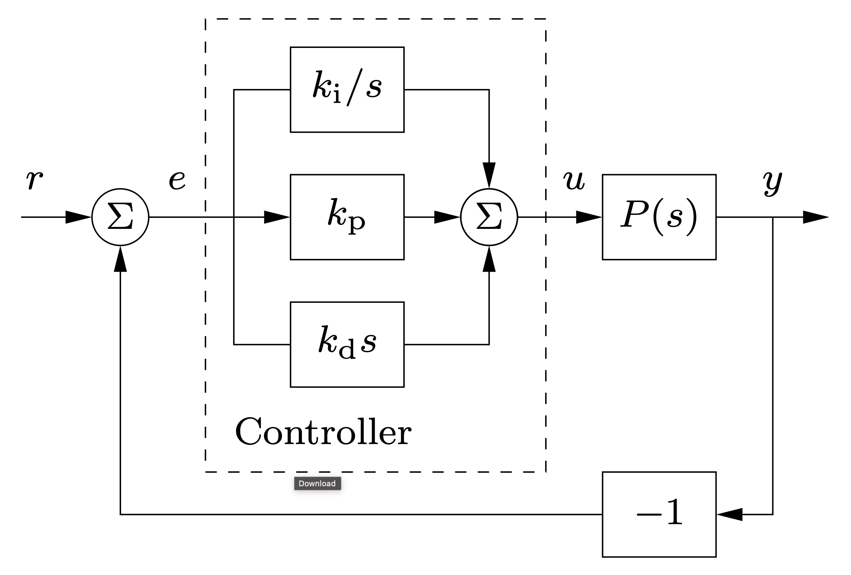
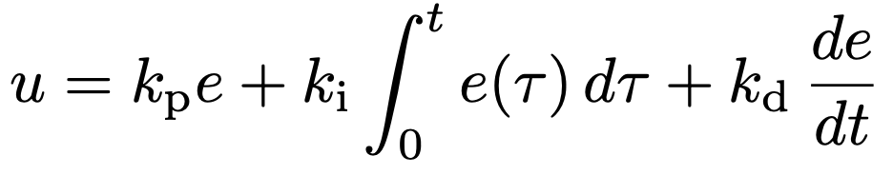
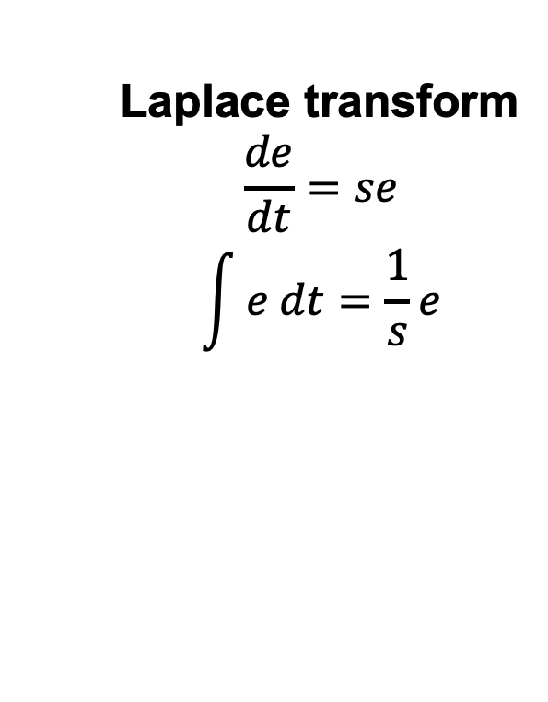
Motor Control: PID at a High Level
Laplace transform
$$\frac{de}{dt}=se$$
$$\int{e dt}=\frac{1}{s}e$$
Proportional
Integral
Derivative
terms which work on the error

Slide 10
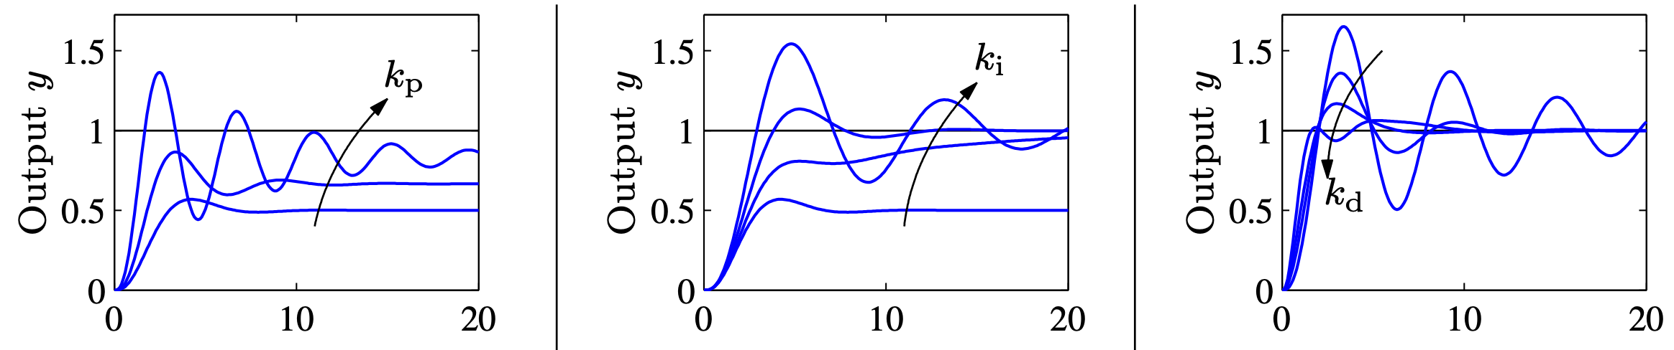
Motor Control: PID at a High Level
Integral = eliminate steady state error
Derivative = damping (resist fast changes)

Slide 11
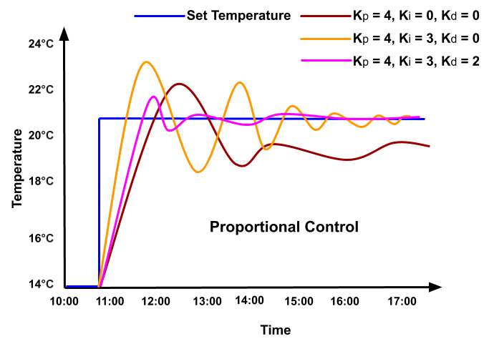
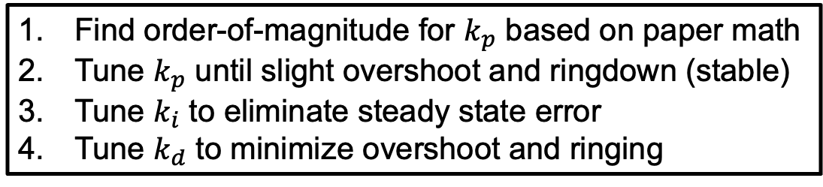
Motor Control: PID Tuning
Find order-of-magnitude for $k_{p}$ based on paper math
Tune $k_{p}$ until slight overshoot and ringdown (stable)
Tune $k_{i}$ to eliminate steady state error
Tune $k_{d}$ to minimize overshoot and ringing

Slide 12
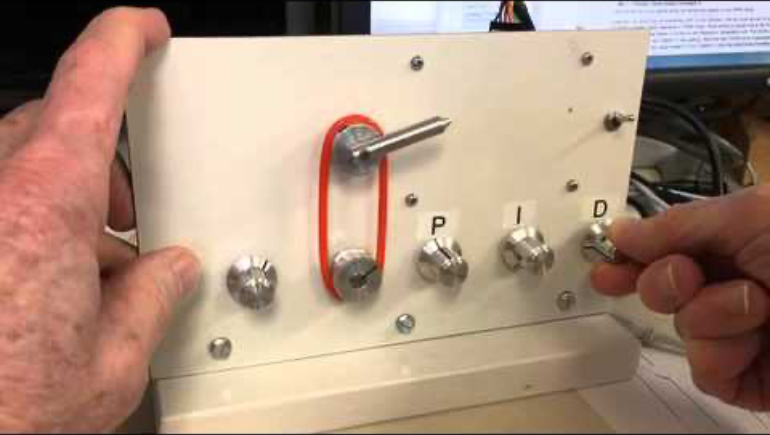
Motor Control: PID Tuning

Slide 13
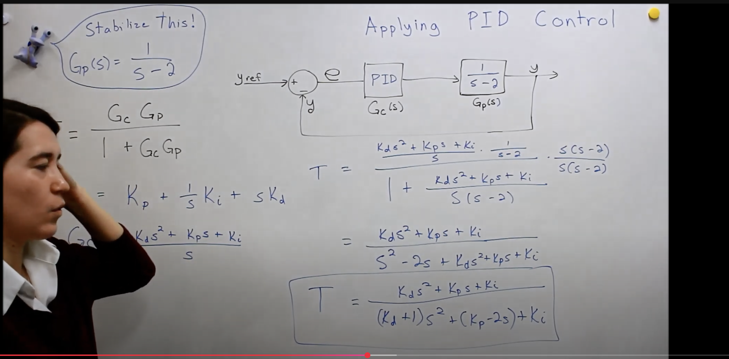
Motor Control: PID at a Low Level
Transfer functions, root locus analysis, …

Slide 14
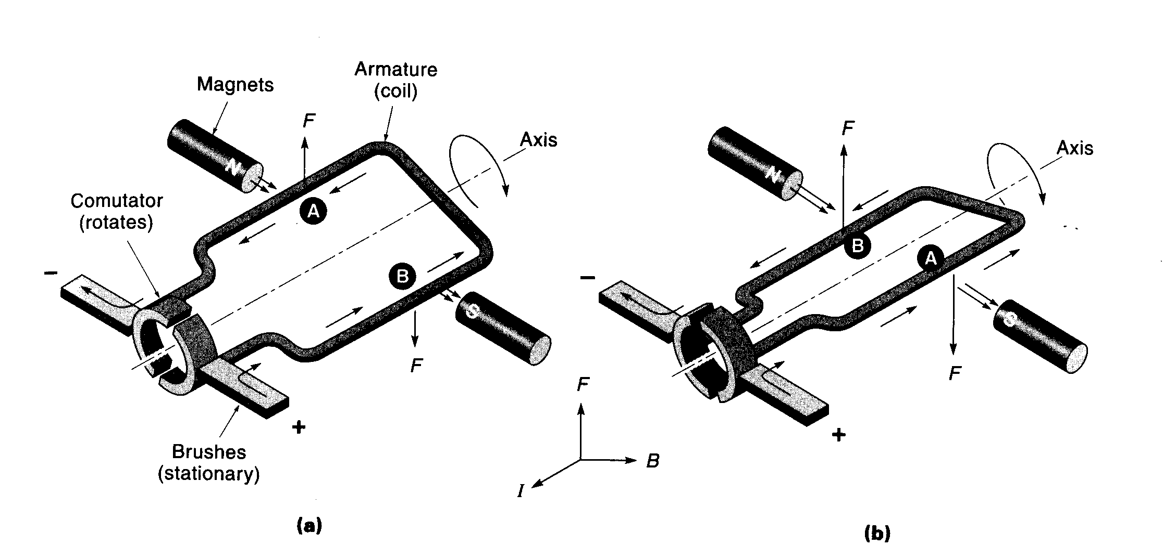
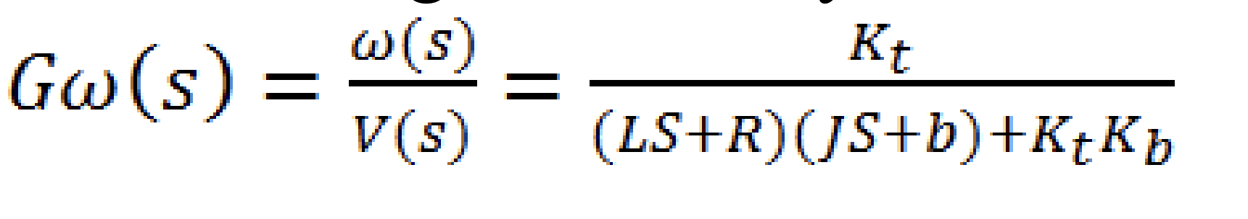
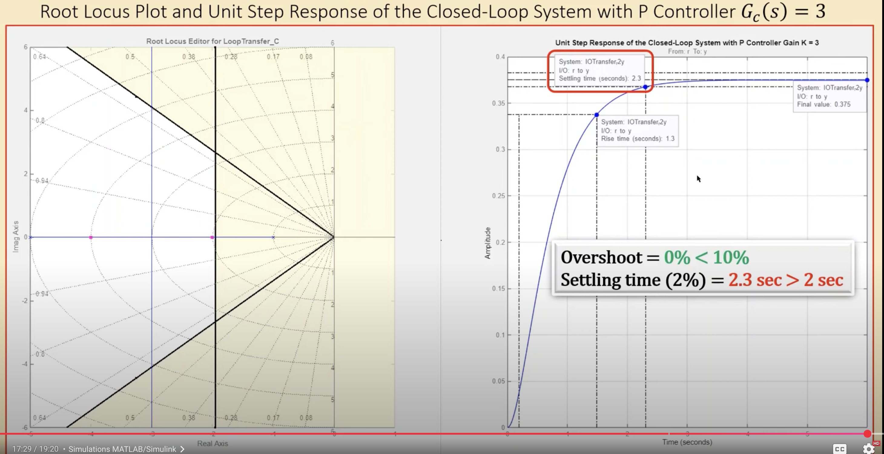
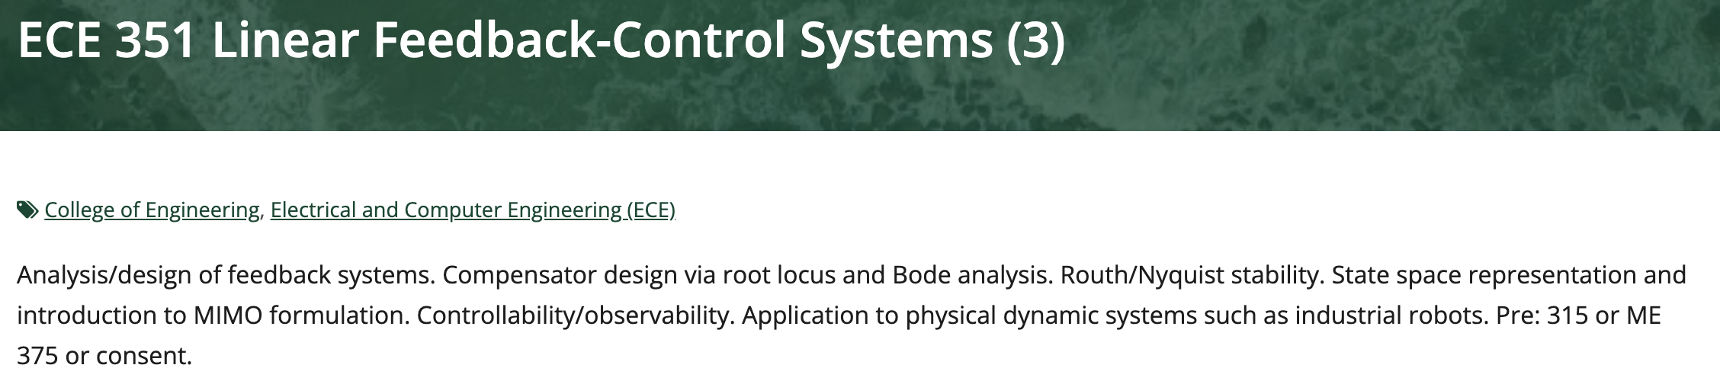
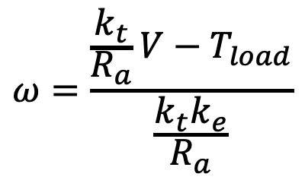
Motor Control: PID at a Low Level
$$ω=\frac{\frac{k_{t}}{R_{a}}V−T_{load}}{\frac{k_{t}k_{e}}{R_{a}}}$$
steady state velocity

Slide 15
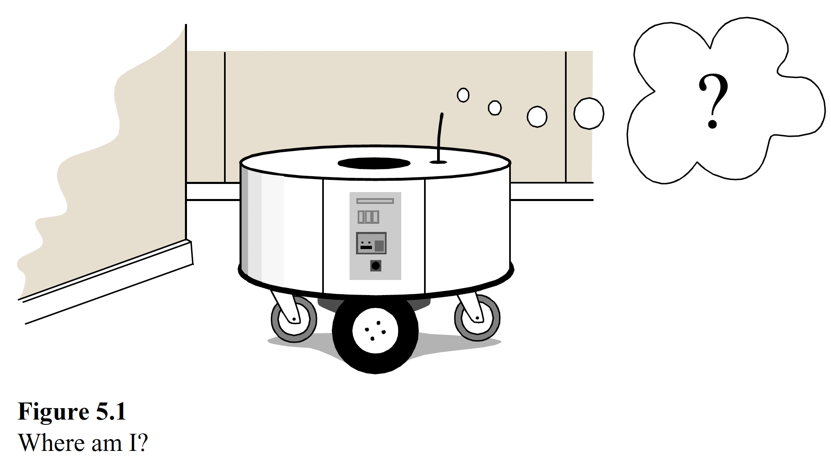
Odometry: Basic Principles

Slide 16
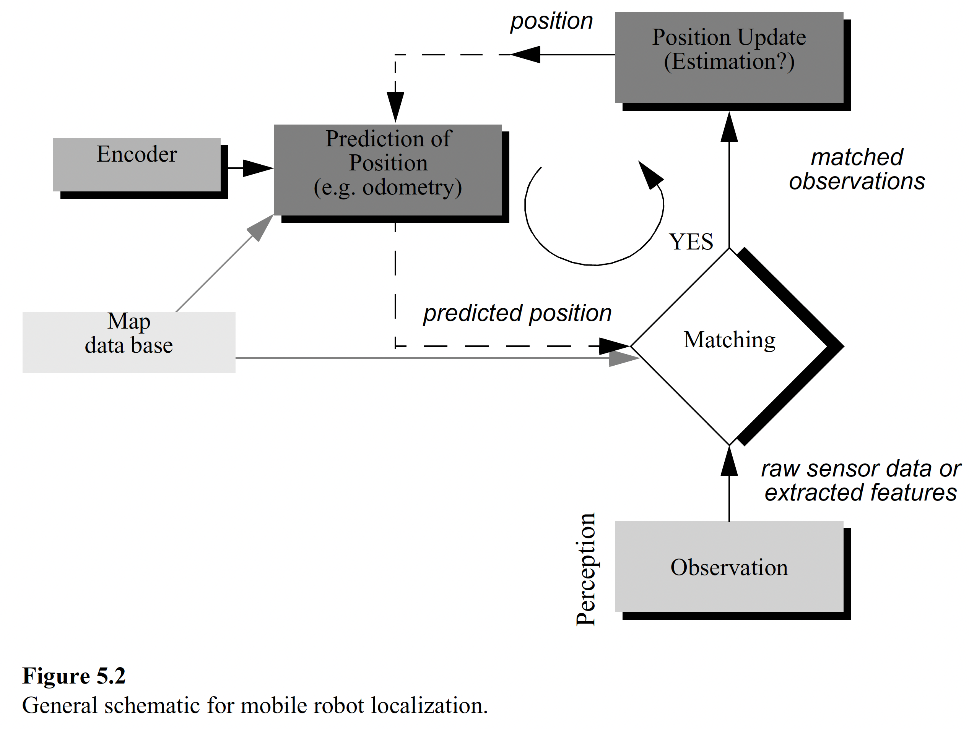
Odometry: Localization - Basic Principle

Slide 17
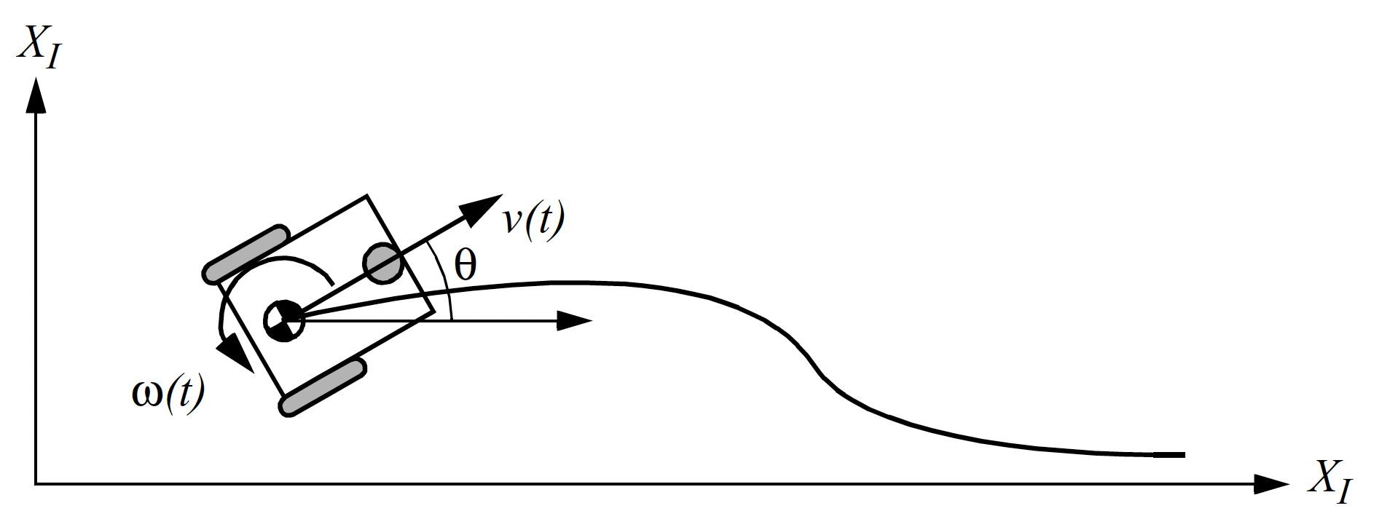
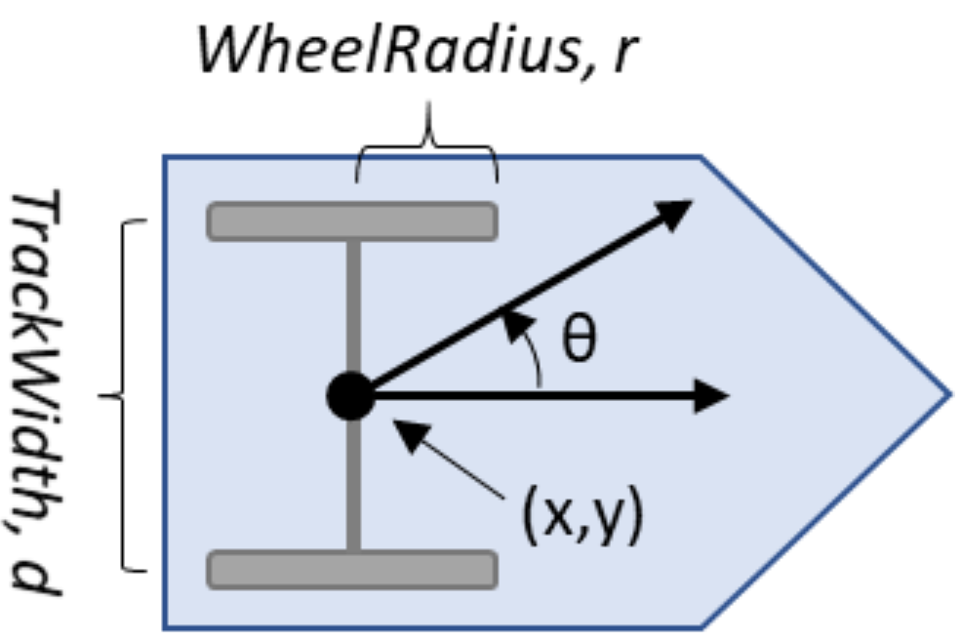
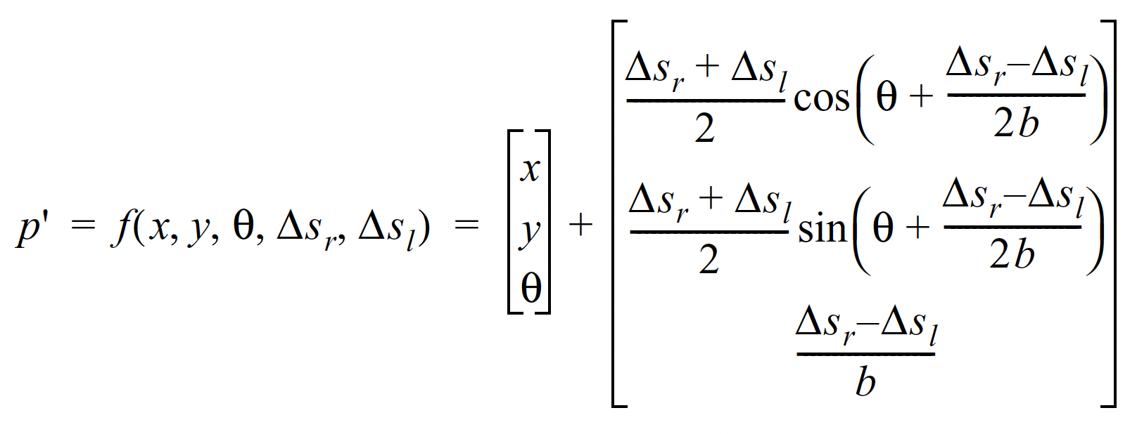
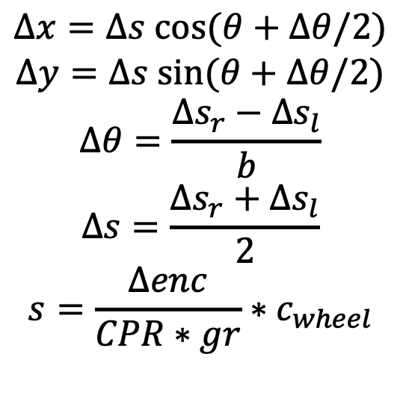
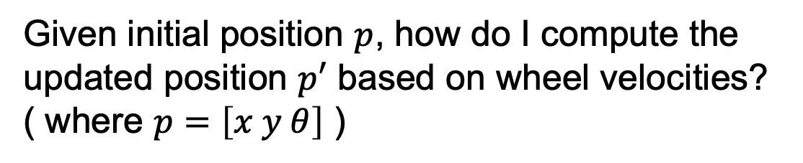
Odometry: Basic Principles
Given initial position $p$, how do I compute the updated position $p′$ based on wheel velocities?
( where $p=\left[x y θ\right]$ )
$$Δx=Δs cos⁡(θ+Δθ/2)$$
$$Δy=Δs sin⁡(θ+Δθ/2)$$
$$Δθ=\frac{Δs_{r}−Δs_{l}}{b}$$
$$Δs=\frac{Δs_{r}+Δs_{l}}{2}$$
$$s=\frac{Δenc}{CPR∗gr}∗c_{wheel}$$

Slide 18
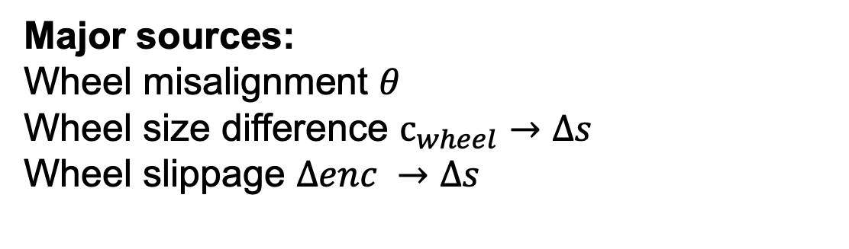
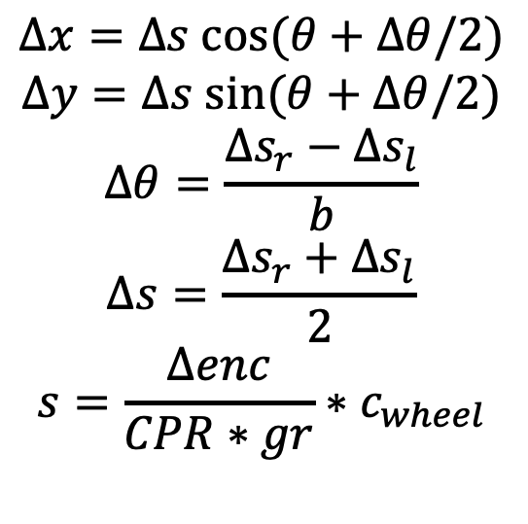
Odometry: Sources of Error
Major sources:
Wheel misalignment $θ$
Wheel size difference $c_{wheel}→Δs$
Wheel slippage $Δenc →Δs$
$$Δx=Δs cos⁡(θ+Δθ/2)$$
$$Δy=Δs sin⁡(θ+Δθ/2)$$
$$Δθ=\frac{Δs_{r}−Δs_{l}}{b}$$
$$Δs=\frac{Δs_{r}+Δs_{l}}{2}$$
$$s=\frac{Δenc}{CPR∗gr}∗c_{wheel}$$

Slide 19
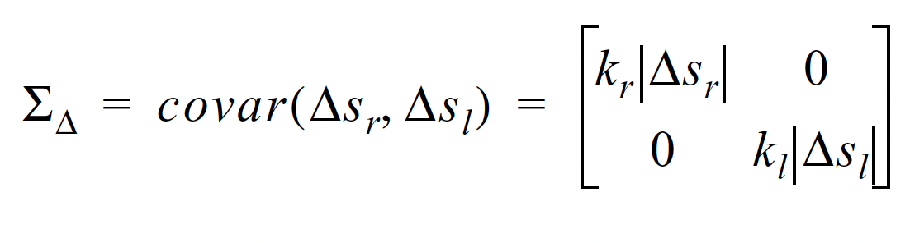
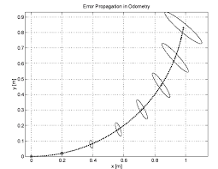
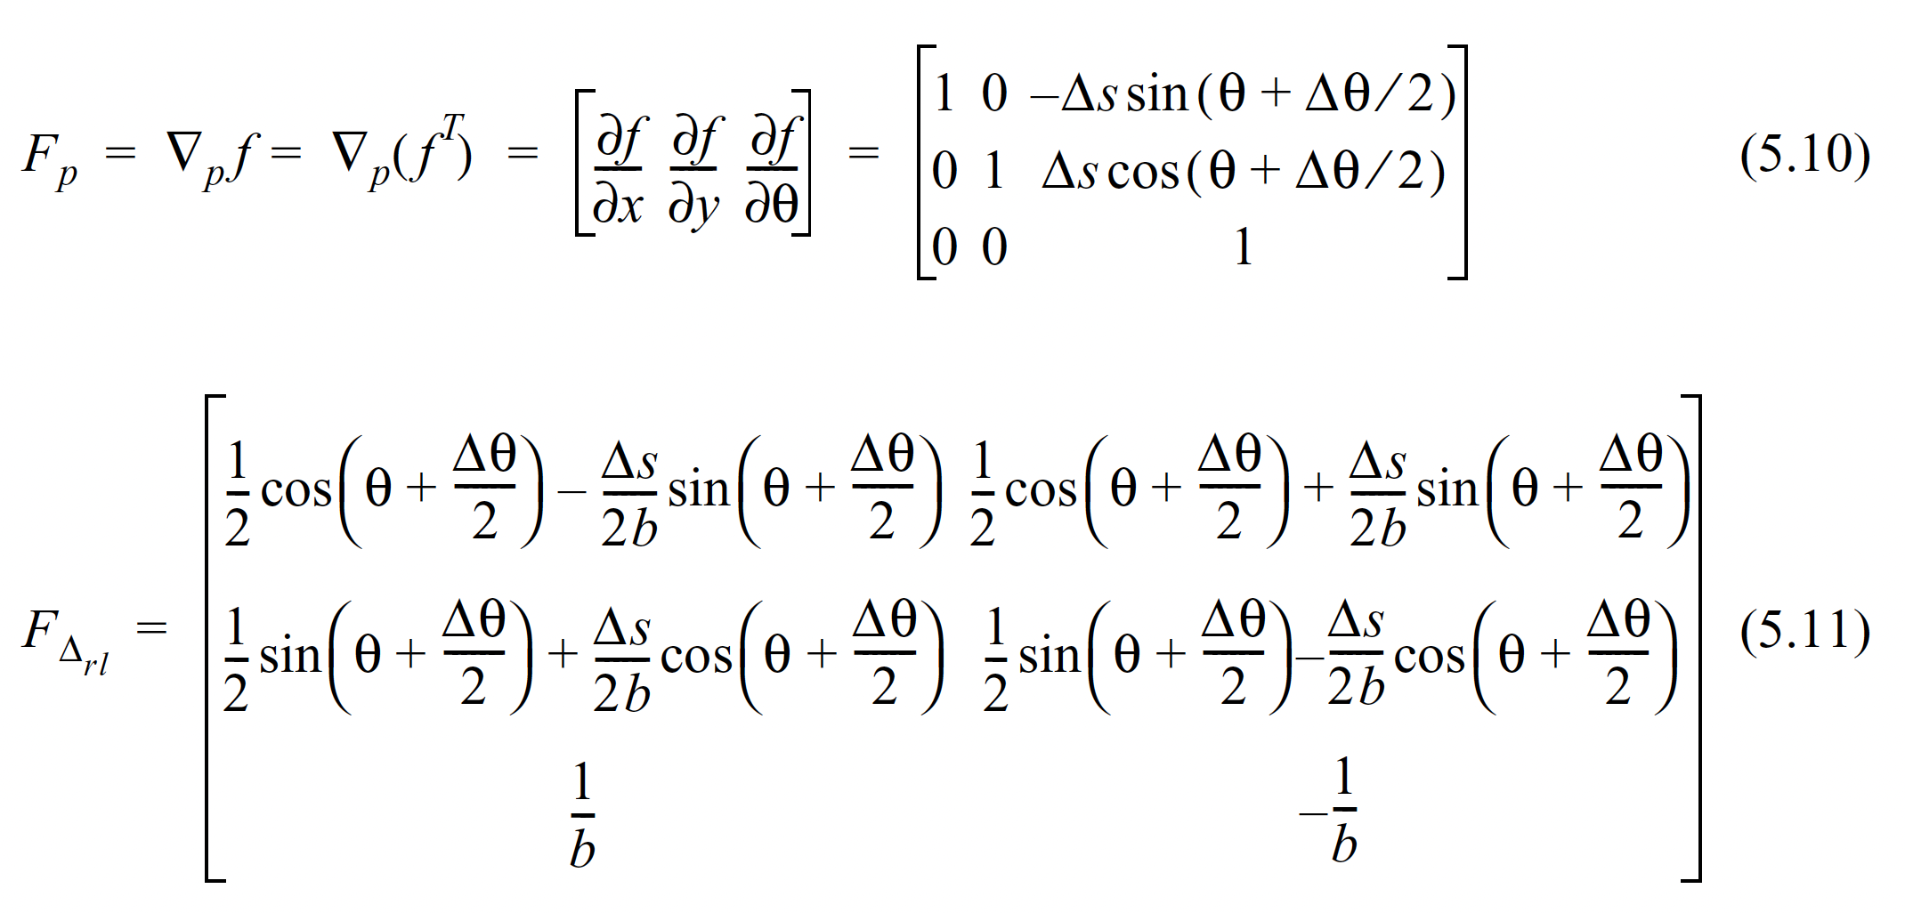
Odometry: Error (mathsplosion)

Slide 20
Odometry: Sensor Fusion
Error based on encoders grows with every estimate…
how to re-zero it?
Use a more trusted reference
(gps, motion capture, …)

Slide 21
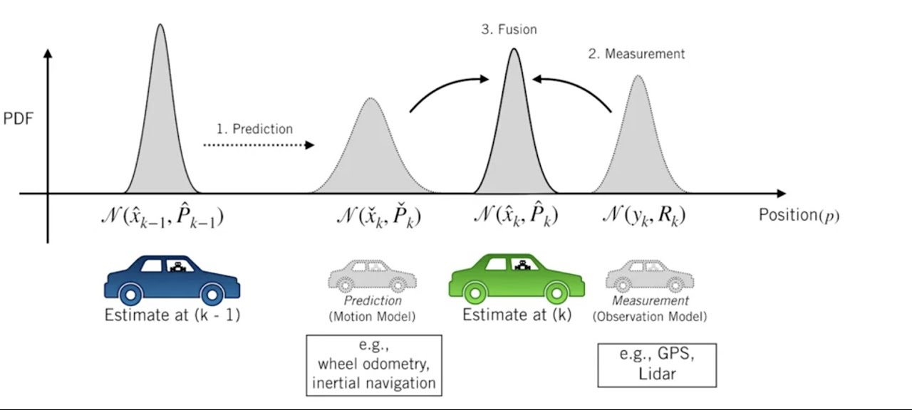
Odometry: Sensor Fusion

Slide 22
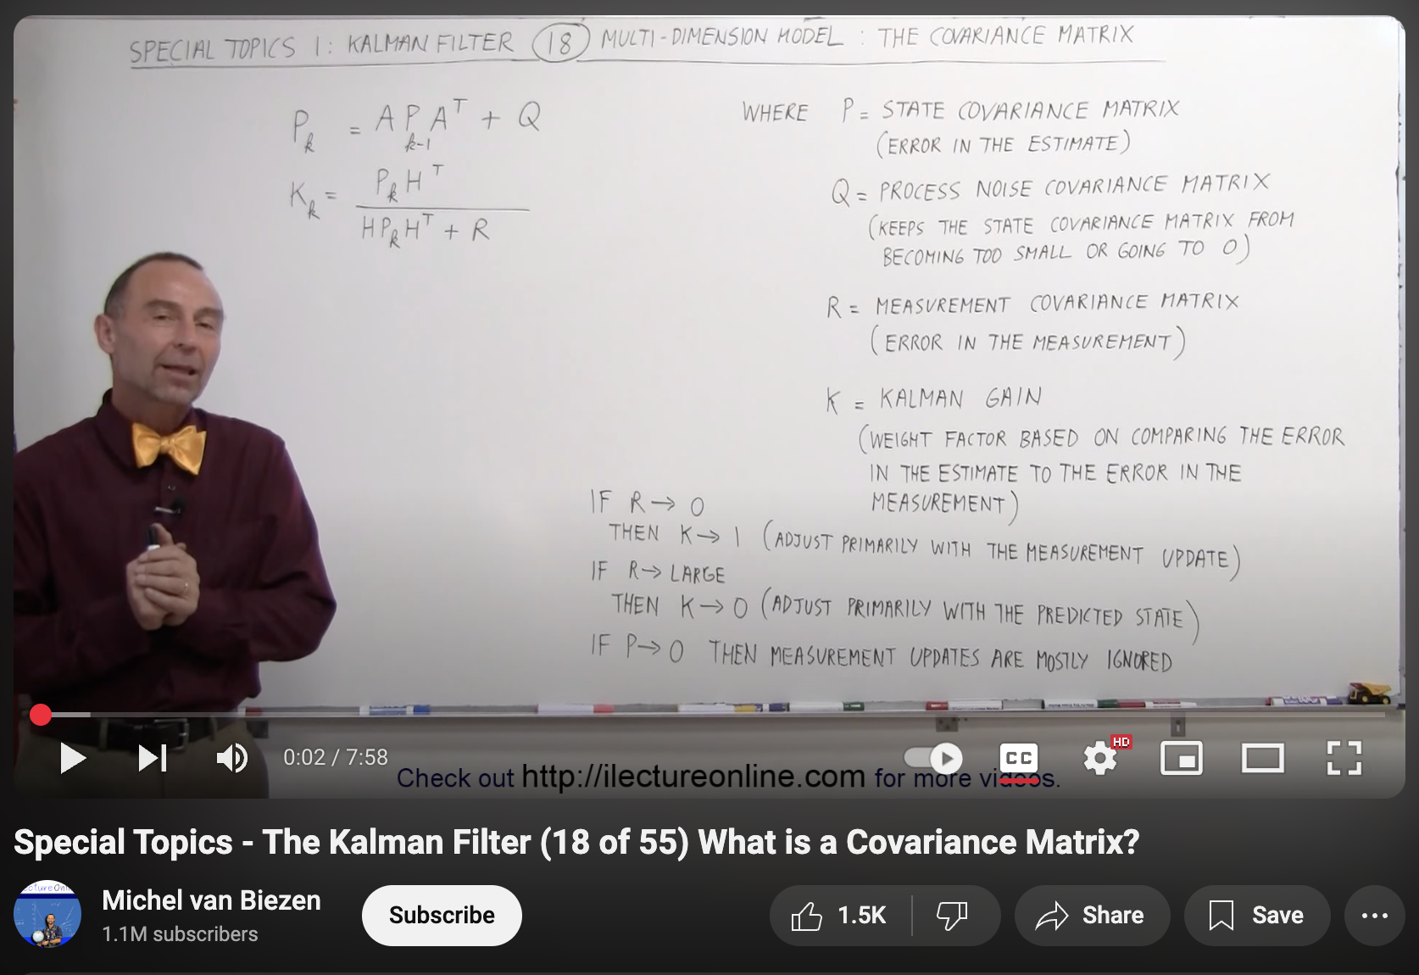
Odometry: Error

Slide 23
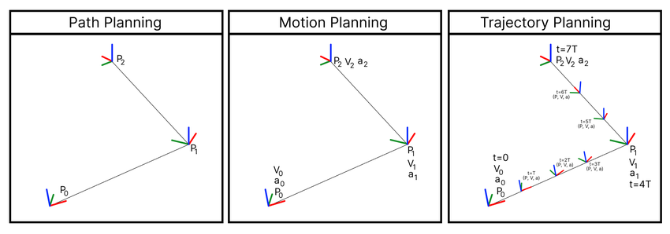
Motion Planning: High Level

Slide 24
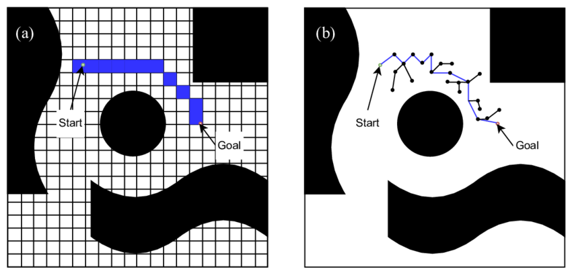
Path Planning: Search vs Sampling
Grid-based Search
Sampling

Slide 25
Path Planning: Search
Given a weighted graph, find the shortest (lowest cost) path from A to B
e.g., A*, Dijkstra’s
Grid-based Search

Slide 26
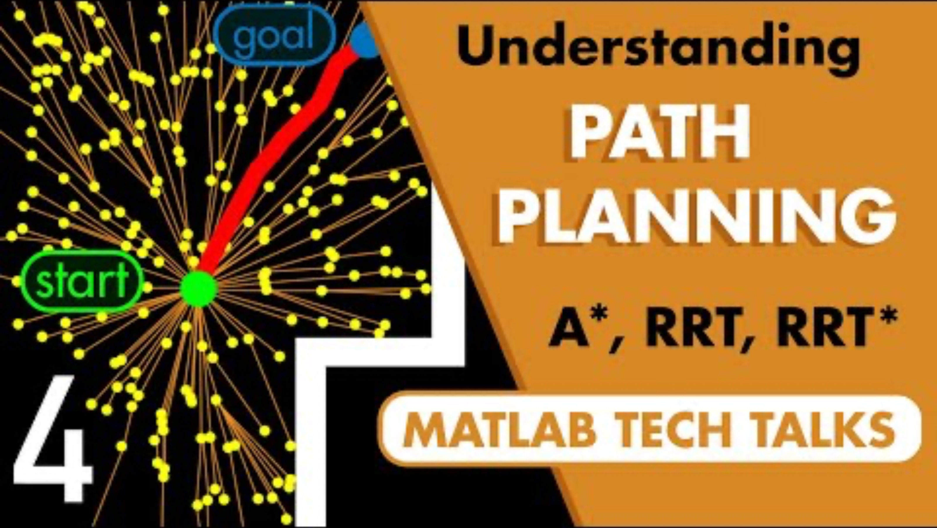
Motion Planning: Graph-based Methods
9:35

Slide 27
Path Planning: Sampling
Given start position and goal position, randomly test (sample) points in the world to find shortest (lowest cost) path
e.g., RRT, RRT*, PRM
Sampling

Slide 28
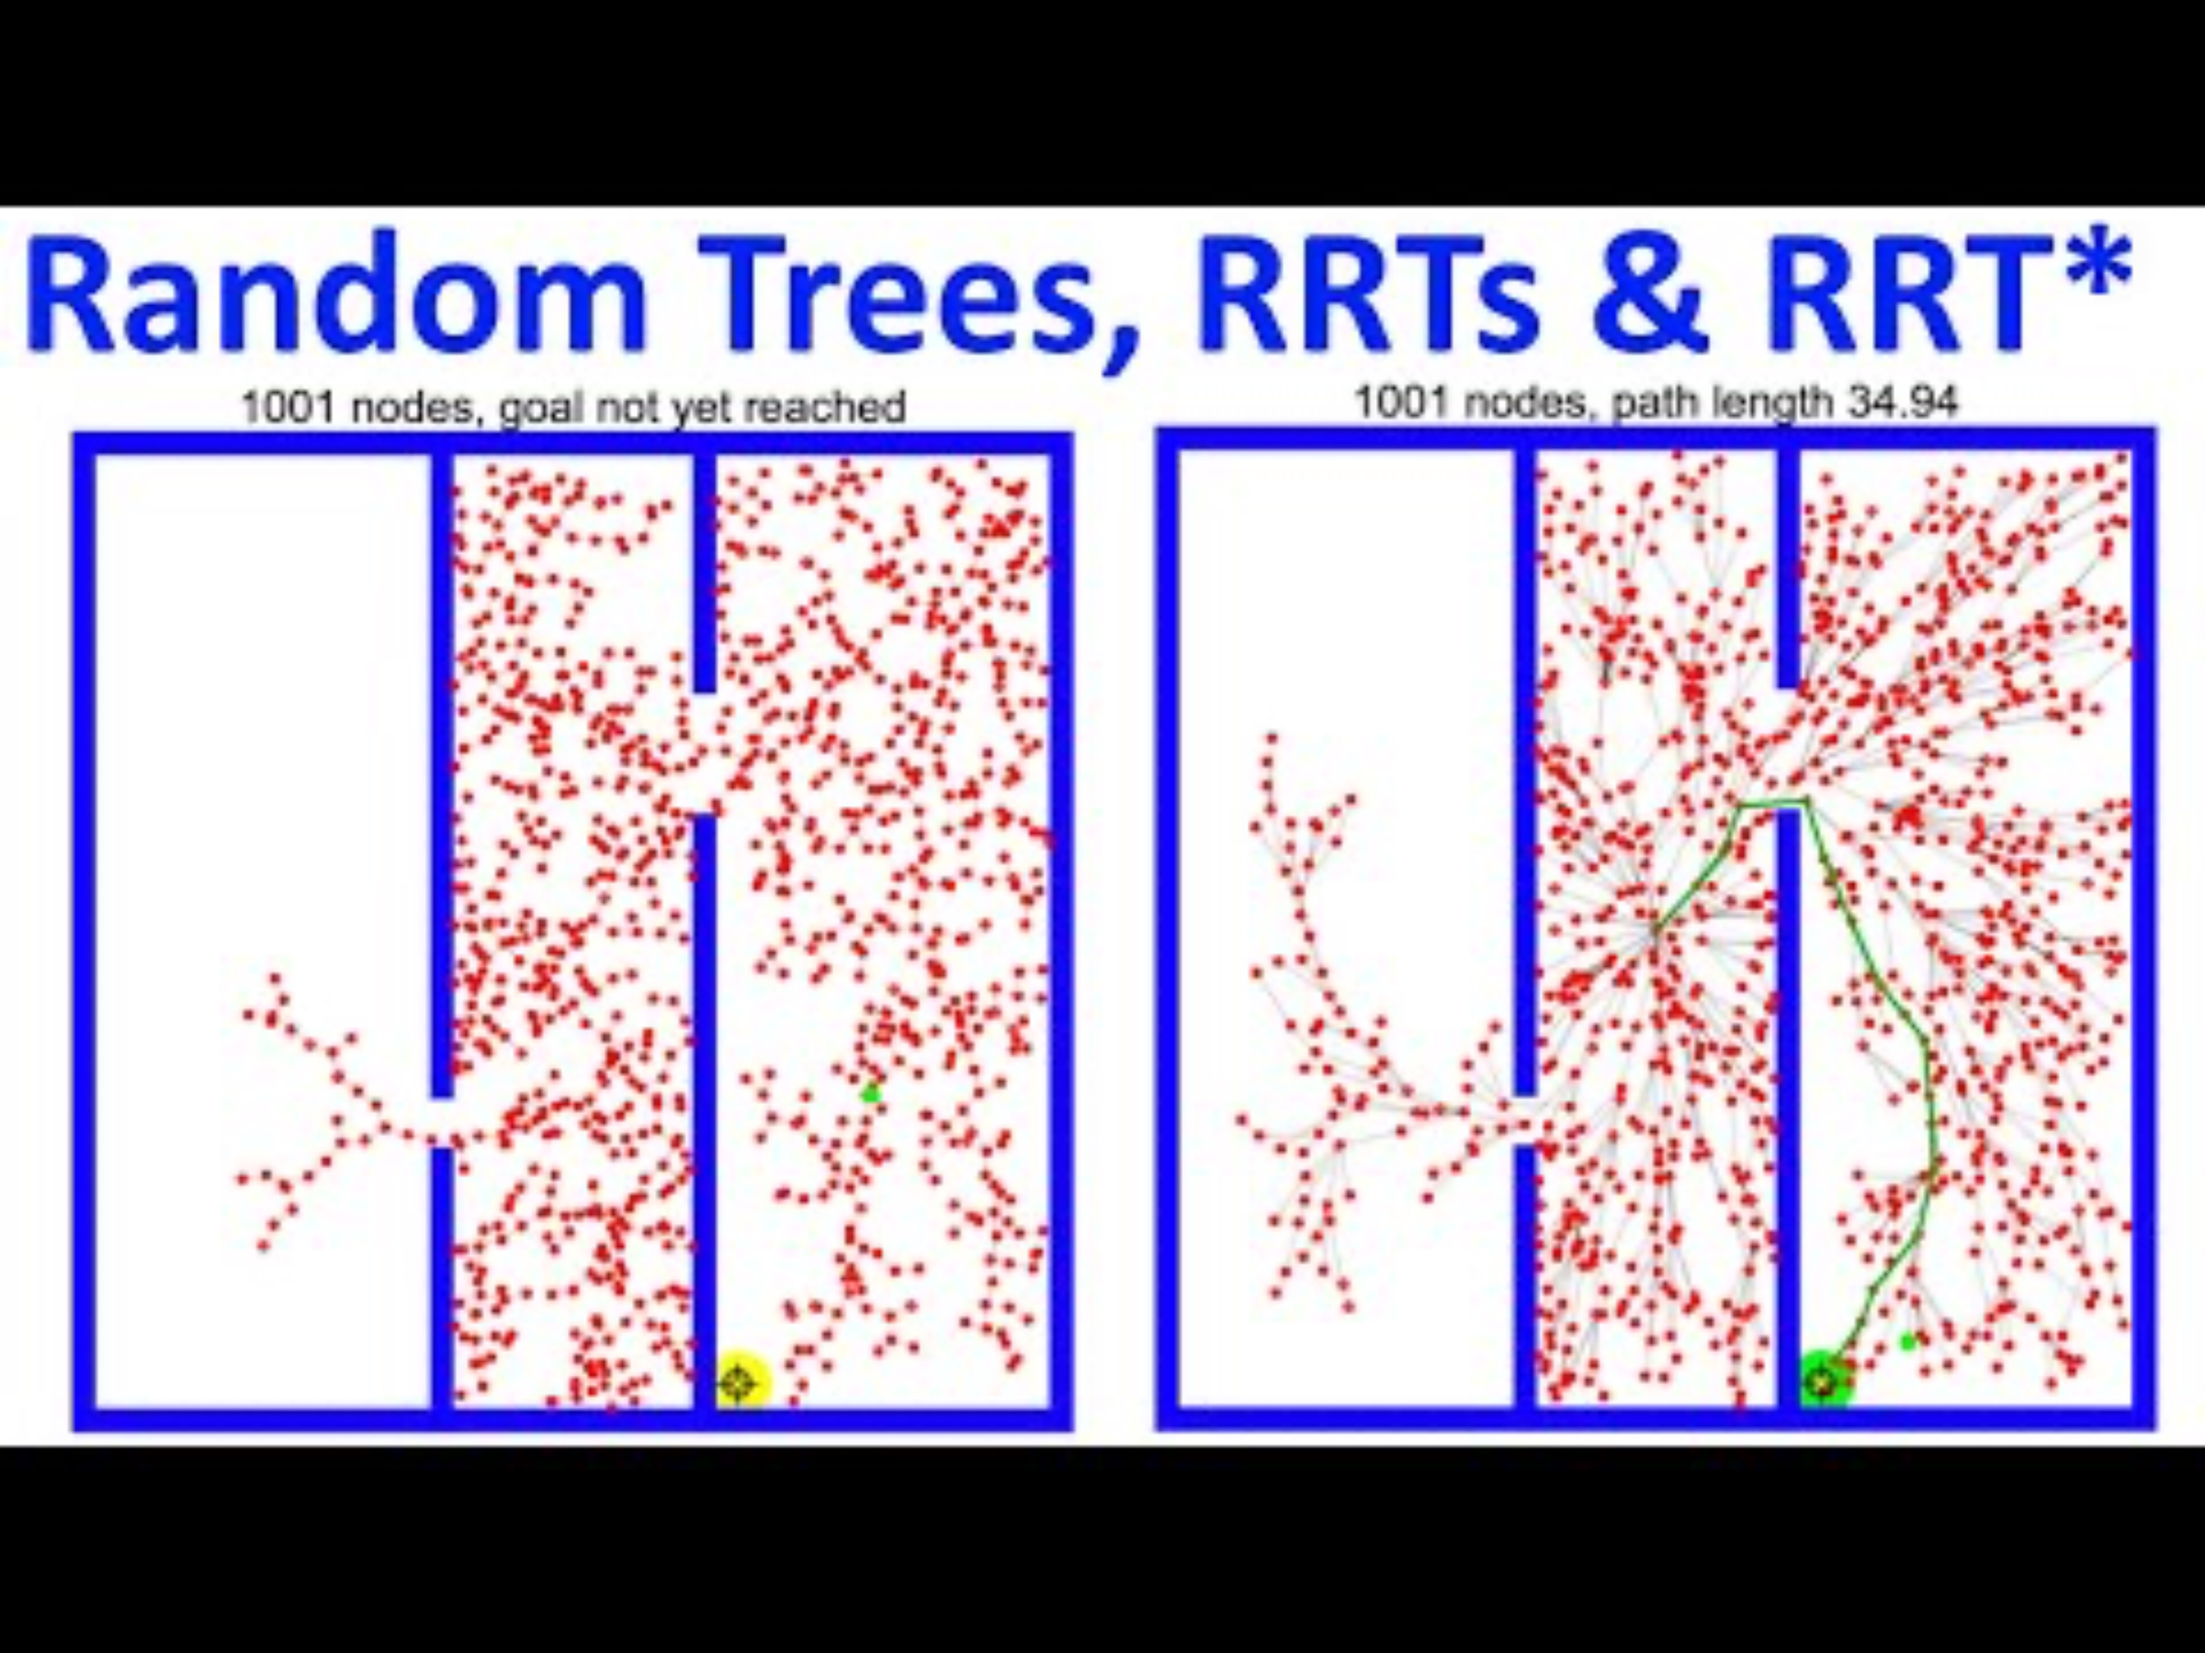
Motion Planning: Search-based Methods
4:00

Slide 29
Motion Planning: Search-based Methods
16:30

Slide 30
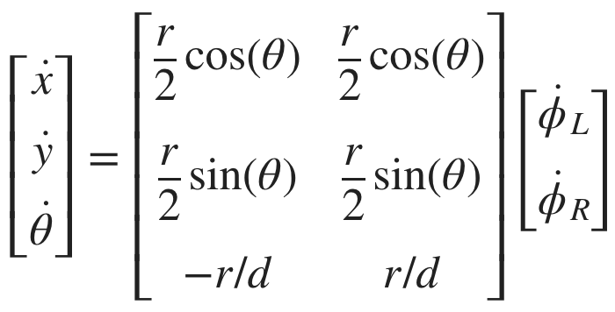
What About Motion Planning
Output of path planning:
A sequence of poses.
Kinematics + odometry gives us:
Change in position given wheel velocities.

Slide 31
SWITCH TO ASTOUND THE CLASS GSLIDES

Slide 32

693H Robotic Subsystems
Motors, drive electronics, encoders, PID controllers, top-down tracking
Sensor suite (IMU, prox.), calibration code, general IO (buttons and LEDs)
Mobility
Perception
Compute and Power
Control and Planning
Battery and charging, wireless comms, GPIO and power distribution routing
microROS, ROS2, Gazebo simulation, enclosure design
Mechanics / Prototyping
Coding
PCB Design

Slide 33
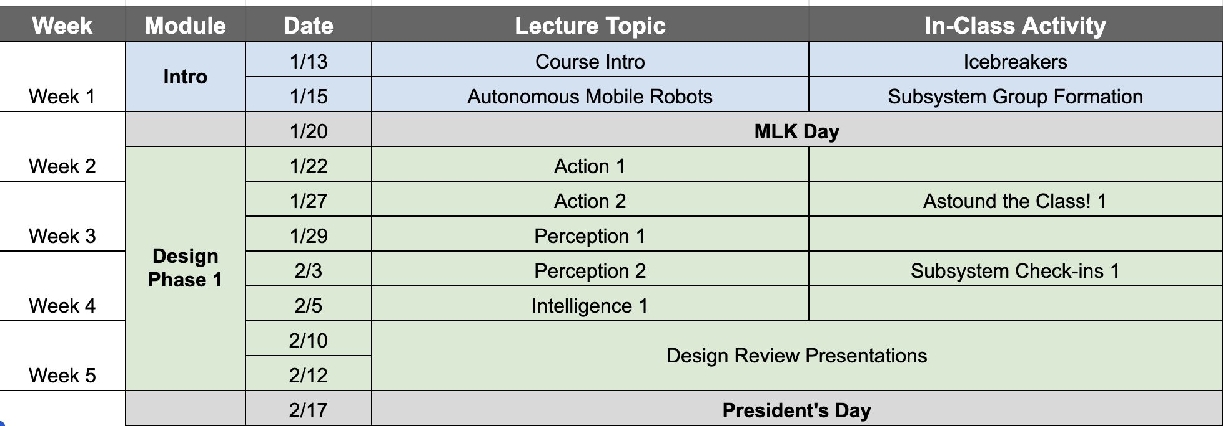
Schedule Check-in
2/3: Parts order, and ~40 minutes in-class work time for check-ins!
Ask questions about Design Review 1 NOW

